Slide 1
Course Overview
CSCI 601-771 (NLP: Advances in Self-Supervised Models)
https://self-supervised.cs.jhu.edu/fa2025/
Notes:
Hi — Welcome to the self-supervised learning class!

Slide 2

Why This Course?
Let’s start with an example: ChatGPT DeepResearch
Notes:
Here I want to tell you what this course is about.
To motivate course, let’s start with an example that many of you are familiar with: ChatGPT.
As I am sure you know this by now, it is a ….

Slide 3
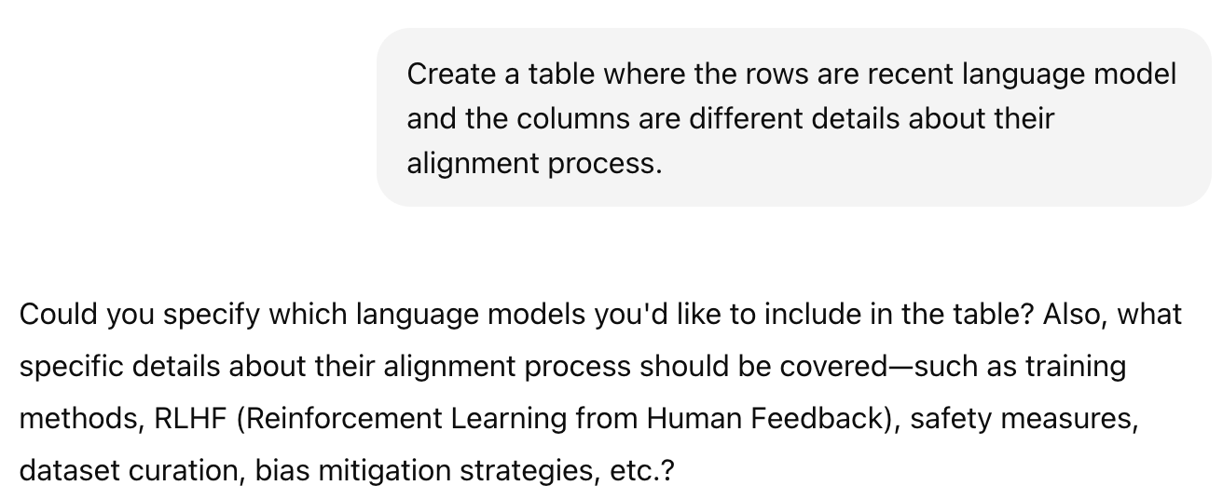
Why This Course?
Let’s start with an example: ChatGPT DeepResearch
Notes:
Here I want to tell you what this course is about.
To motivate course, let’s start with an example that many of you are familiar with: ChatGPT.
As I am sure you know this by now, it is a ….

Slide 4
Why This Course?
Let’s start with an example: ChatGPT DeepResearch
Notes:
Here I want to tell you what this course is about.
To motivate course, let’s start with an example that many of you are familiar with: ChatGPT.
As I am sure you know this by now, it is a ….

Slide 5
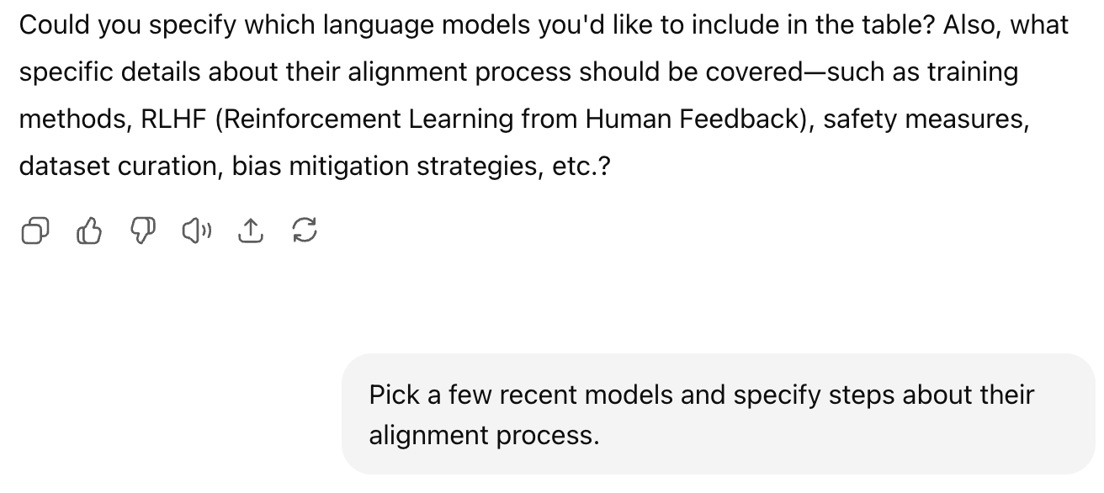
Why This Course?
Notes:
Here I want to tell you what this course is about.
To motivate course, let’s start with an example that many of you are familiar with: ChatGPT.
As I am sure you know this by now, it is a ….

Slide 6
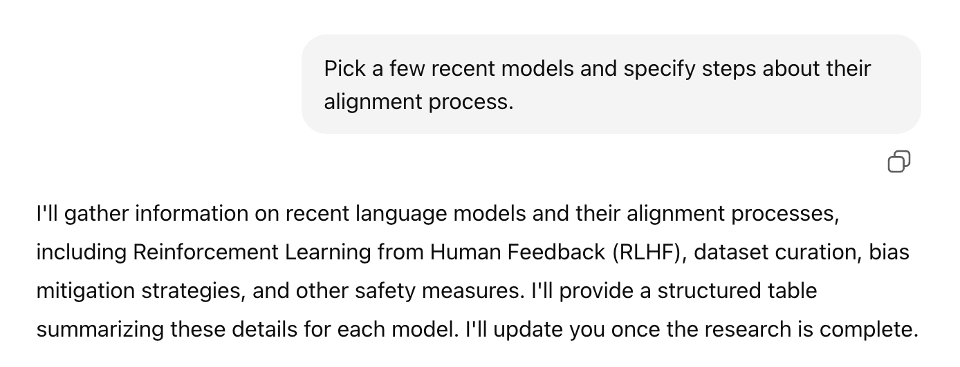
Why This Course?
Notes:
Here I want to tell you what this course is about.
To motivate course, let’s start with an example that many of you are familiar with: ChatGPT.
As I am sure you know this by now, it is a ….

Slide 7


Slide 8
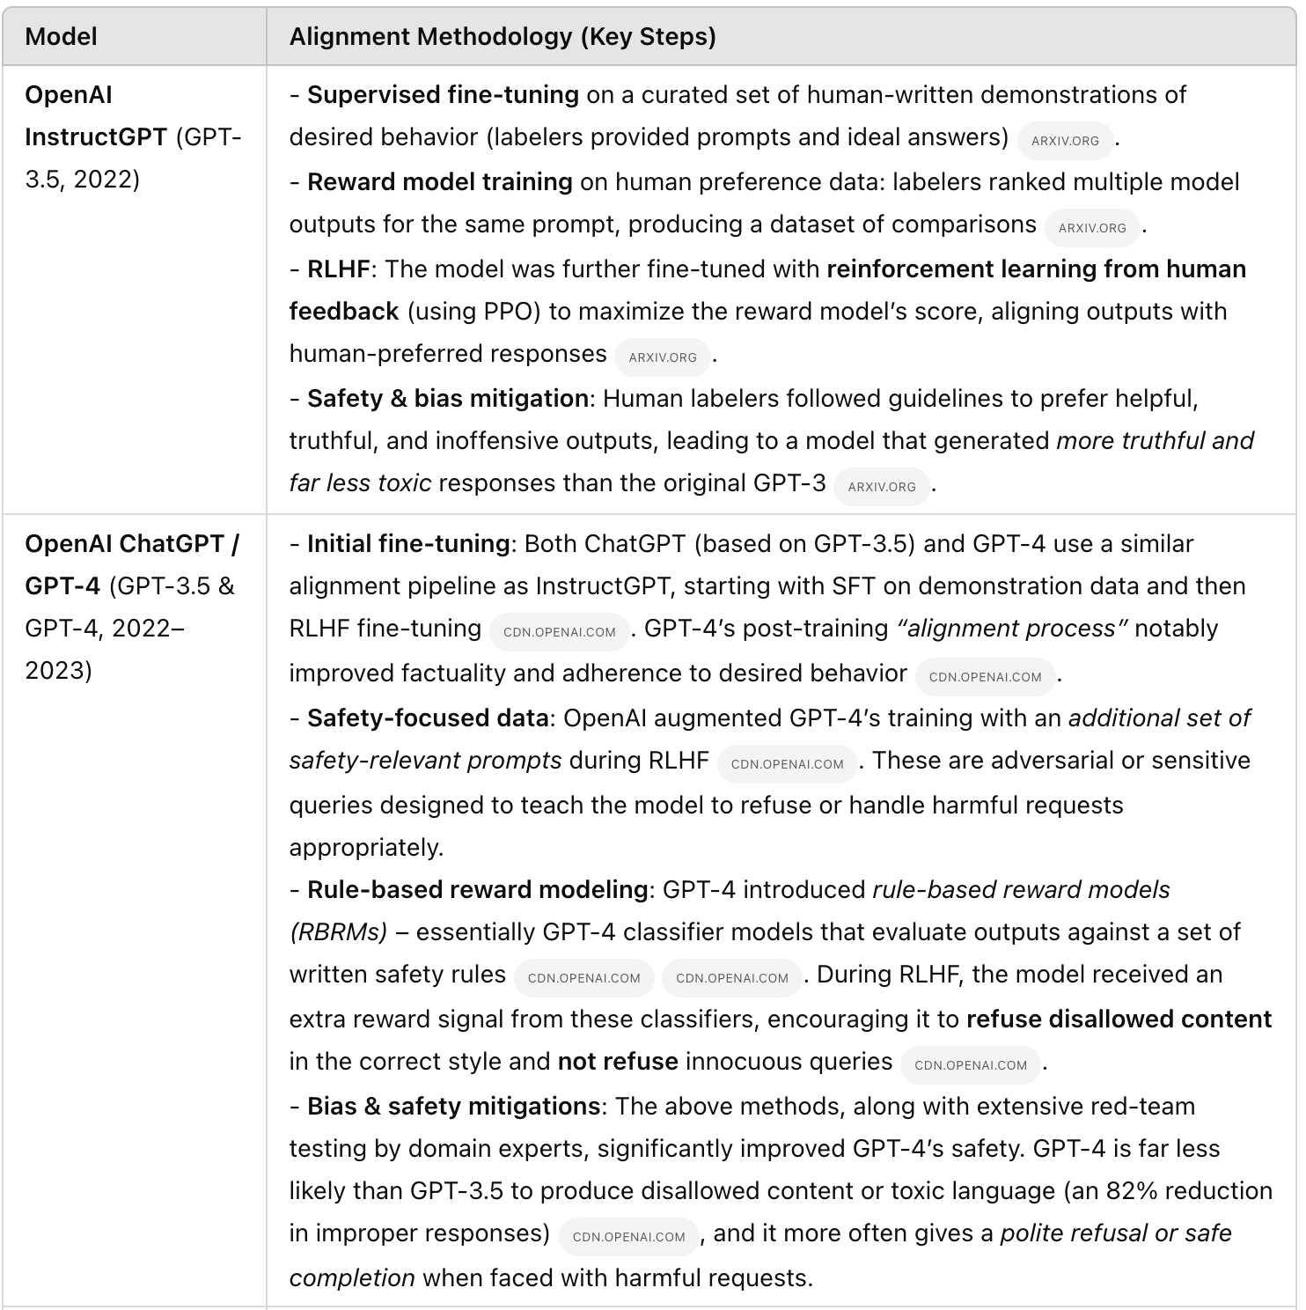
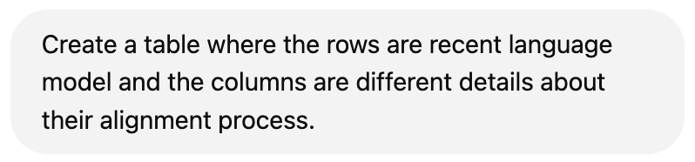

ChatGPT Deep Search (~10 mins)
Looks impressive; doesn’t it?
Example retrieved on 03/13/2025
Notes:
Here I want to tell you what this course is about.
To motivate course, let’s start with an example that many of you are familiar with: ChatGPT.
As I am sure you know this by now, it is a ….

Slide 9
ChatGPT
Can write essays, gather related ideas, expand your research idea, debug your code, etc.
How is it able to do these? 🤔
What are the principles that govern this technology?
Can we replicate it?
Can we extend it?
Notes:
This is great!
ChatGPT can …
In this class, we want to go deeper. We want to understand the engineering details that lead to marvelous products such as ChatGPT.
Specifically, we will try to address questions like …

Slide 10
Meanwhile …

Slide 11
ChatGPT Deep Search (~10 mins)
GPT 3.5 has two rows?
Incorrect information (precision issues)
Lots of text, not much structure/insight.
Example retrieved on 03/13/2025
Notes:
However, you may use the OpenAI "deep search" feature. And that's a fair question to ask.
I issued my question to ChatGPT DeepSearch. Waited roughly 20 minutes.
And got these results. Evidently more information.
But perhaps too much text, and let's structure. What's the point of using tables if you're going to fill it in with so much text? It's so hard to glean any insights from these results.
Moreover, some information is inaccurate here. The response certain research work from OpenAI (such as rule-based reward modeling), but there is no evidence that they're part of GPT-4's public release. So, these are precision issues.
(and I don't why GPT3 is mentioned in two rows).

Slide 12
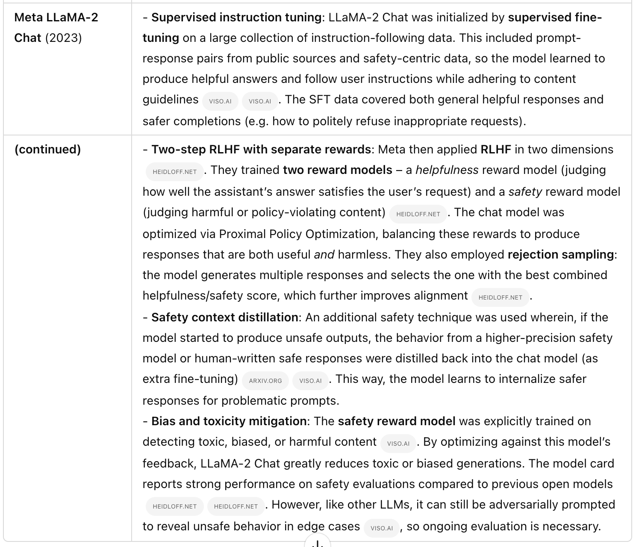
No reference to Llama2 paper itself?
???
ChatGPT Deep Search (>15 mins)
The table has these models: GPT-3.5, GPT-4, Claude, Sparrow, LaMDA, LLaMA-2 What about the rest? Recall issue.
Example retrieved on 03/13/2025
Notes:
If I scroll down, you can see results, llama2, but notice that all these citations are to blog posts, not the llama2 paper itself, which shows that the system is not good at identifying important citations, which is crucial for science.
You can also see that the results are missing a lot of important, recent models, which shows the deep search has recall issues as well.
Hopefully by now I have conviced you that even Deep Search does not solve this problem.

Slide 13
The table I created on my own
Language Model | Release | Base | Alignment Algorithm(s) Used | Alignment Data Sources for alignment
GPT-3-instruct | 2020 | GPT-3 | SFT --> RLHF/PPO | Curated datasets with human-labeled prompts and responses
GPT-4 | 2023 | GPT-4 pre-trained? | SFT --> RLHF/PPO | Curated datasets with human-labeled prompts and responses
Gemini | 2023 | Gemini pre-trained? | SFT --> RLHF/PPO | Curated datasets with human-labeled prompts and responses
LLaMA2 | 2023 | LLaMA2 pre-trained | SFT --> RLHF/PPO | Curated datasets with human-labeled prompts and responses
LLaMA3 | 2024 | LLaMA3 pre-trained | Iterate: Rejection sampling -> SFT -> DPO | 10 million human-annotated examples. The alignment process was conducted over multiple rounds, with each round involving the collection of new preference annotations and SFT data.
Alpacha | 2023 | LLAMA 1 | SFT | Self-Instruct, 52,000 input-output pairs
Qwen2.5 | 2024 | Qwen2.5 pre-trained | SFT -> DPO -> GRPO | 1 million samples
Tulu 3 | 2024 | Llama 3.1 | SFT -> DPO -> RLVR | near 1 million samples
DeepSeek (V3) | 2024 | DeepSeek pre-trained | SFT -> GRPO | 1.5 million samples (reasoning + non-reasoning tasks). Reasoning data was generated by specialized models. Non-reasoning data was produced by DeepSeek-V2.5 and validated by human reviewers.
What I manually created for my course

Slide 14
AI (e.g., Deep Research) is far from perfect
LLMs know about many interesting connections. But can they be more precise?
LLMs are fluent and verbose.
Remarkable on the first sight.
But quickly becomes a problem for information overload.
Note that this was an easy prompt — extensively discussed online (papers, Twitter, Reddit, etc.) and hence, during pre-training.
Why does it make such surprisingly simple mistakes? 🤔
Can we explain these?
Can we predict them?
Can we mitigate (or even better, solve) them?

Slide 15
Course Learning Objectives
Broad research question:
Reasoning: Understanding LLMs ability and limitations in performing complex, multi-step inference.
Long inputs/output: Understanding LLMs ability and limitations in processing long inputs and generating long outputs.
Efficient inference: Understanding the latest advances and hurdles in efficient inference.
Skills:
Technical—understanding of the algorithms and implementing them.
Gaining intuitions about capabilities and limitations of models.
Soft skills—intuition about capabilities, teamwork.

Slide 16
Course Learning Objectives
We will cover a variety of inter-related topics:
Architectures
Pre-training
Alignment and safety
Efficiency
Interaction with the world (code, physical world, etc.)
Impacts on humans -- their misuse, biases, etc.
Skills:
Technical—understanding of the algorithms and implementing them.
Gaining intuitions about capabilities and limitations of models.
Soft skills—algorithms, PyTorch, SLURM, intuition about capabilities, teamwork.

Slide 17
Focus on Natural/Human Language
Most of the class revolves around natural language.
Why natural language?
It is a convenient medium of communication.
Natural language is our species’ best attempt to encode everything about the world as efficiently as possible.
A huge archive of natural language is freely available (e.g., on the web).

Slide 18
Self-Supervised Models

Slide 19
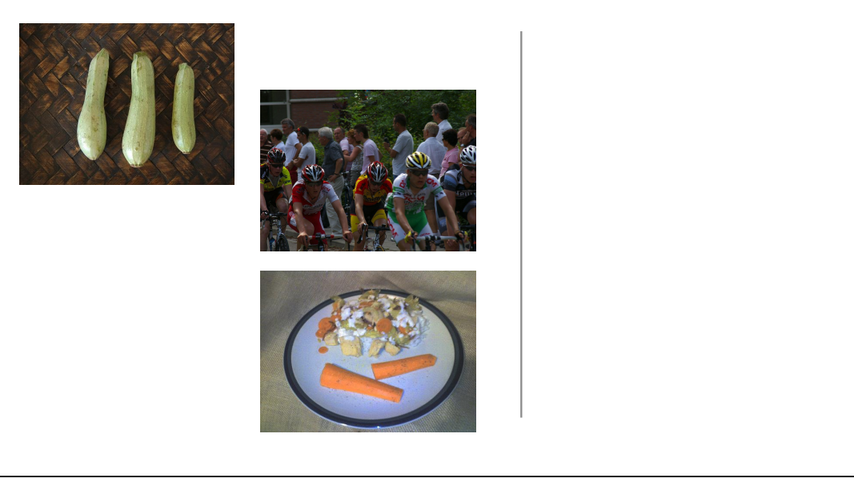
Self-Supervision
[Slide credit: Colin Raffel]
Notes:
Let's start with a example. Let's say I go out into the world and collect a dataset of natural images. So, first I get this picture of some cyclists…

Slide 20
Self-Supervision
[Slide credit: Colin Raffel]
Notes:
then a few more photos

Slide 21
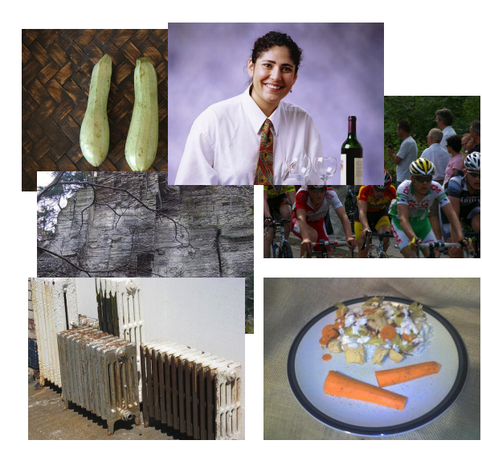
Self-Supervision
[Slide credit: Colin Raffel]
Notes:
And then a few more photos

Slide 22
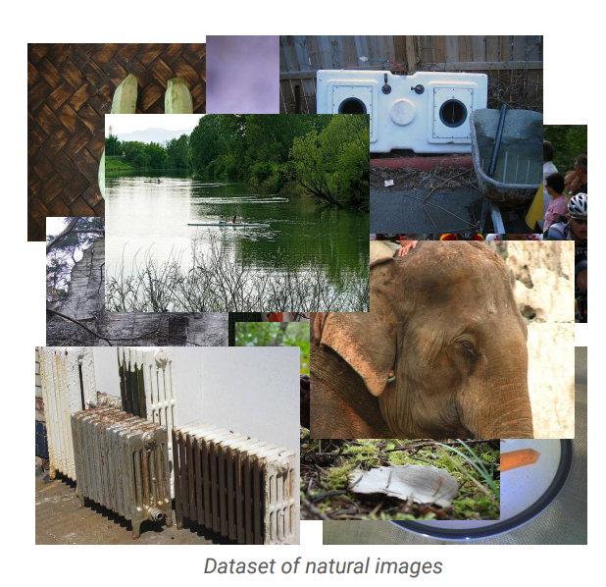
Self-Supervision
[Slide credit: Colin Raffel]
Notes:
And eventually, I will have a large collection of natural images.
One can assume that these images are samples from some true distribution - the distribution of natural images.
The idea is to take this training set and learn a model and hopefully by doing so, this model will be a good approximation of the reality.
That is, if we draw new samples from my model they should appear like the kind of images you’d see in reality, even though these generated images may not be simple copies from our training set.

Slide 23
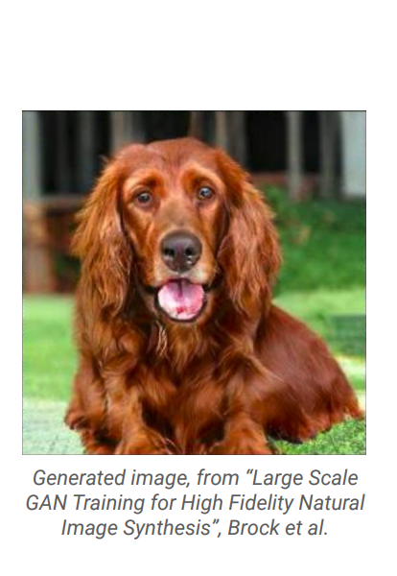
Self-Supervision
[Slide credit: Colin Raffel]
Notes:
Here's an example of an image produced by a recent generative model developed by some researchers at DeepMind.
The generative model has made up this dog completely on its own.
It has never seen this particular dog before in the training set, either.
To my eyes at least, it's hard to tell that this is a generated image and not a real picture of a dog.

Slide 24
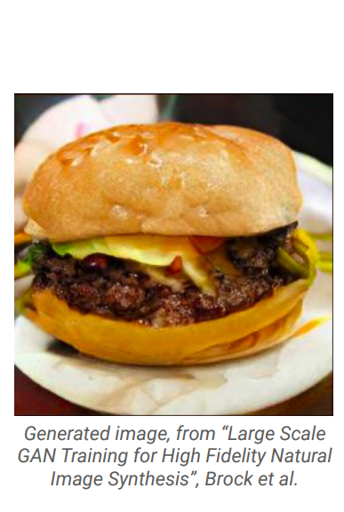
Self-Supervision
[Slide credit: Colin Raffel]
Notes:
And here's another one.
I for one would be happy to eat this made-up cheeseburger.
The fact that the model is able to produce these images suggests that it has learned about the structure of the natural world.
The model has done this without explicit supervision - it was simply shown millions of images and discovered this structure itself.

Slide 25
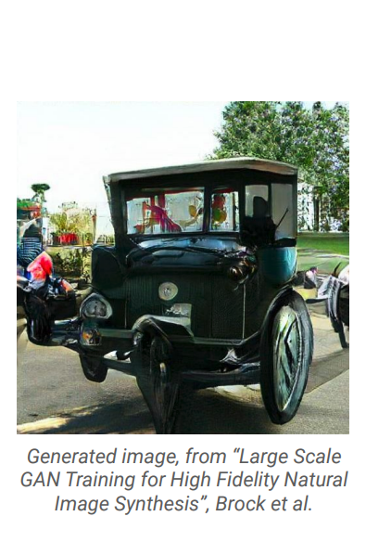
Self-Supervision
[Slide credit: Colin Raffel]
Notes:
Of course, this model is not perfect -- sometimes it generates things like this quasi-car.

Slide 26
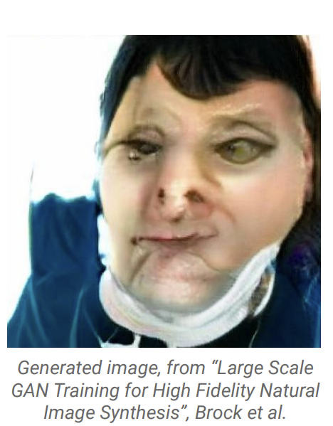
Self-Supervision
[Slide credit: Colin Raffel]
Notes:
Even worse, it hasn't really figured out what human faces look like.
This is likely because the dataset it was trained on has a relatively low proportion of images of people’s faces.

Slide 27
Self-Supervision
== treaty of paris (1763) the treaty of paris, also known as the treaty of 1763, was signed on 10 february 1763 by the kingdoms of great britain, france and spain, with portugal in agreement, after great britain's victory over france and spain during the seven years' war. the signing of the treaty formally ended the seven years' war, known as the french and indian war in the north american theatre, ….
[Slide credit: Colin Raffel]
Notes:
This same paradigm can be applied to other domains outside of natural images. For example, let's say we collect articles from Wikipedia.

Slide 28
Self-Supervision
== wheelbarrow
A wheelbarrow is a small hand-propelled vehicle, usually with just one wheel, designed to be pushed and guided by a single person using two handles at the rear, or by a sail to push the ancient wheelbarrow by wind. The term "wheelbarrow" is made of two words: "wheel" and "barrow." "Barrow" is a derivation of the Old English "barew" which was a device used for carrying loads. The wheelbarrow is designed to …..
== treaty of paris (1763) the treaty of paris, also known as the treaty of 1763, was signed on 10 february 1763 by the kingdoms of great britain, france and spain, with portugal in agreement, after great britain's victory over france and spain during the seven years' war. the signing of the treaty formally ended the seven years' war, known as the french and indian war in the north american theatre, ….
[Slide credit: Colin Raffel]

Slide 29

Self-Supervision
== lemon
The lemon (Citrus limon) is a species of small evergreen trees in the flowering plant family Rutaceae, native to Asia, primarily Northeast India (Assam), Northern Myanmar or China.[2] The tree's ellipsoidal yellow fruit is used for culinary and non-culinary purposes throughout the world, primarily for its juice, which has both culinary and cleaning uses.[2] The pulp and rind are also used in cooking and baking. ….
== wheelbarrow
A wheelbarrow is a small hand-propelled vehicle, usually with just one wheel, designed to be pushed and guided by a single person using two handles at the rear, or by a sail to push the ancient wheelbarrow by wind. The term "wheelbarrow" is made of two words: "wheel" and "barrow." "Barrow" is a derivation of the Old English "barew" which was a device used for carrying loads. The wheelbarrow is designed to …..
== treaty of paris (1763) the treaty of paris, also known as the treaty of 1763, was signed on 10 february 1763 by the kingdoms of great britain, france and spain, with portugal in agreement, after great britain's victory over france and spain during the seven years' war. the signing of the treaty formally ended the seven years' war, known as the french and indian war in the north american theatre, ….
Dataset of Wikipedia articles
[Slide credit: Colin Raffel]
Notes:
Once we have a large dataset of articles …

Slide 30
Self-Supervision
== lemon
The lemon (Citrus limon) is a species of small evergreen trees in the flowering plant family Rutaceae, native to Asia, primarily Northeast India (Assam), Northern Myanmar or China.[2] The tree's ellipsoidal yellow fruit is used for culinary and non-culinary purposes throughout the world, primarily for its juice, which has both culinary and cleaning uses.[2] The pulp and rind are also used in cooking and baking. ….
== wheelbarrow
A wheelbarrow is a small hand-propelled vehicle, usually with just one wheel, designed to be pushed and guided by a single person using two handles at the rear, or by a sail to push the ancient wheelbarrow by wind. The term "wheelbarrow" is made of two words: "wheel" and "barrow." "Barrow" is a derivation of the Old English "barew" which was a device used for carrying loads. The wheelbarrow is designed to …..
== wings over kansas wings over kansas is the second studio album by jason ammons, john bolster and mo rosato. the album debuted at number one on the billboard 200, selling 35,000 copies in it first week at the time. it was the second highest selling album to debut at the billboard top 50 and the third highest selling album to debut at the top heatseekers, with 26,000 copies sold. this is the supremes album earning the nickname …
== treaty of paris (1763) the treaty of paris, also known as the treaty of 1763, was signed on 10 february 1763 by the kingdoms of great britain, france and spain, with portugal in agreement, after great britain's victory over france and spain during the seven years' war. the signing of the treaty formally ended the seven years' war, known as the french and indian war in the north american theatre, ….
Dataset of Wikipedia articles
[Slide credit: Colin Raffel]
Notes:
we can train a generative model to generate new Wikipedia articles.
In this example. the generated article discusses a made-up album called Wings over Kansas.
The model was only given the title of the article and filled in the rest.
You can see that the model has learned not only basic sentence structure, grammar, and spelling, but also the kind of content which is typical in Wikipedia articles.
It also stays on theme, though it does end up generating some nonsense near the end.
Based these examples, you should start to get the idea if “self-supervision”. Let’s try to make our definition more concrete.

Slide 31
Self-Supervised Models
are predictive models of the world!
Notes:
The first thing that you should notice is that, …
To make it a bit more concrete, …

Slide 32
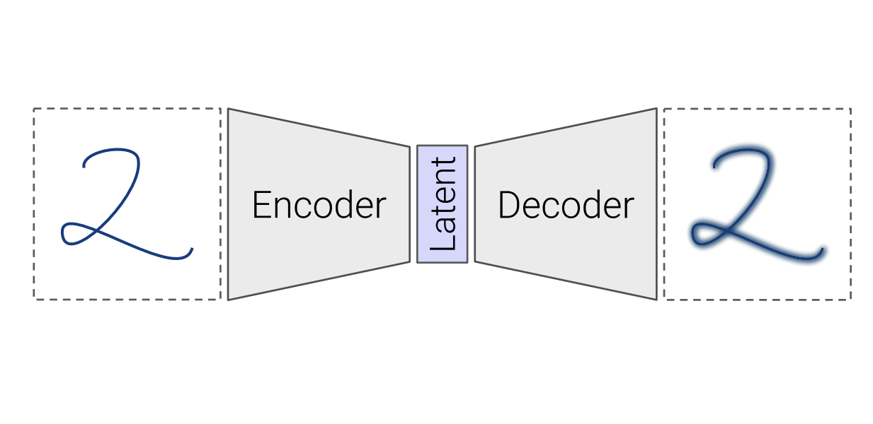
Self-Supervised Models
are predictive models of the world!
Are trained to complete partial samples from the world.
Mask
[Bengio et al. 2004, Hinton et al. 2006, Peters et al. 2018, …]
Notes:
Let’s go back to the self-supervised understanding of the visual world.
In this case, an example of a self-supervised model is one that is trained to fill in partial instances of the world.
For example, a model that is trained to reconstruct the missing portions of the images that are partially masked out.
For a model to successfully reconstruct an image, it needs to have an internal predictive model of the world.
And to build such a model, we can basically train it on partially-masked samples (take a bunch of pictures; mask out parts of them and make you model reconstruct the missing part).

Slide 33
Self-Supervised Models
are predictive models of the world!
Are trained to complete partial samples from the world.
“Wings over Kansas is an aviation website founded in 1998 by Carl Chance owned by Chance Communications, Inc.”
“Wings over Kansas is [MASK]”
[Bengio et al. 2004, Hinton et al. 2006, Peters et al. 2018, …]
Notes:
Similarly, in the context of understanding human language, you can view a self-supervised model as one that can effectively complete partial sentences.
Because doing so would require the model to have formed a predictive distribution of natural sentences in English language.

Slide 34
Self-Supervised Models
are predictive models of the world!
learned from cheaply available unlabeled data
Notes:
Besides being a predictive model of the world, self-supervised models are trained on cheaply available unlabled data
And because we are talking about unlabeld data, we are talking about massive amount of …

Slide 35
Self-Supervised Models
are predictive models of the world!
learned from cheaply available unlabeled data
Notes:
For instance, freely available text documents that you would get for free on the internet.
Or all the images that you might see on the web.
Or the videos available on the web.
Basically, any sensory signal in the world can be used to train self-supervised models.
And that is exactly why we call them “self-supervised” because you don’t need to annotate data for training these models, at least for the most part.

Slide 36
Self-Supervised Models
Here is an example …
are tightly connected to tasks we care about.
Notes:
Putting all these together, we get this definition: …
This was my definition of self-supervised models.

Slide 37
Self-Supervised Models
are tightly connected to tasks we care about.
Goal: Answering questions
Question: “Where is the birthplace of the American national anthem?”
✍️
“The birthplace of the American national anthem, "The Star-Spangled Banner," lies in Baltimore, Maryland.”
“The birthplace of the American national anthem” [MASK]
Produced with GPT-J: https://6b.eleuther.ai/
Notes:
And a 3rd property that self-supervised models have is that they’re tightly connected to tasks that we care about in the real world.
Let me give you an example.
Imagine you want to answer an English question – which is something that we frequently want to do daily.
And you want to solve this with a self-supervised model of language that can predict the ending of the sentences.
All you you need to do is to modify your question to a statement that needs to be completed by our self-supervised model and there you get the answer [read it]
You see, the change is not that big to map our desired problem to a language that is understandable to our model.

Slide 38
Self-Supervised Models
Are predictive models of the world.
Are learned from unlabeled data.
Tightly connected to tasks we care about.
Notes:
Putting all these together, we get this definition: …
This was my definition of self-supervised models.

Slide 39
How did we get here?

Slide 40
Progress in AI
Many advances are due to neural networks
How old are neural networks?
[Slide credit: Arman Cohan]
Notes:
So the truth is that, the progress in many of the relevant topics started a long time ago.
Many of these models are based on neural networks that have been around for several decades.

Slide 41
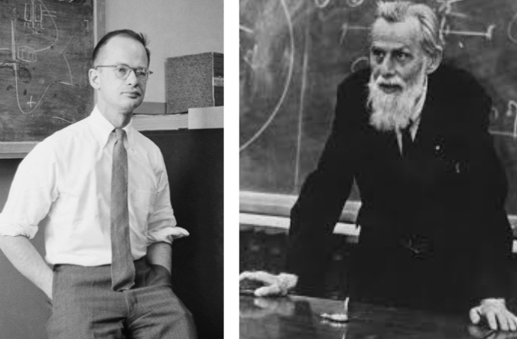
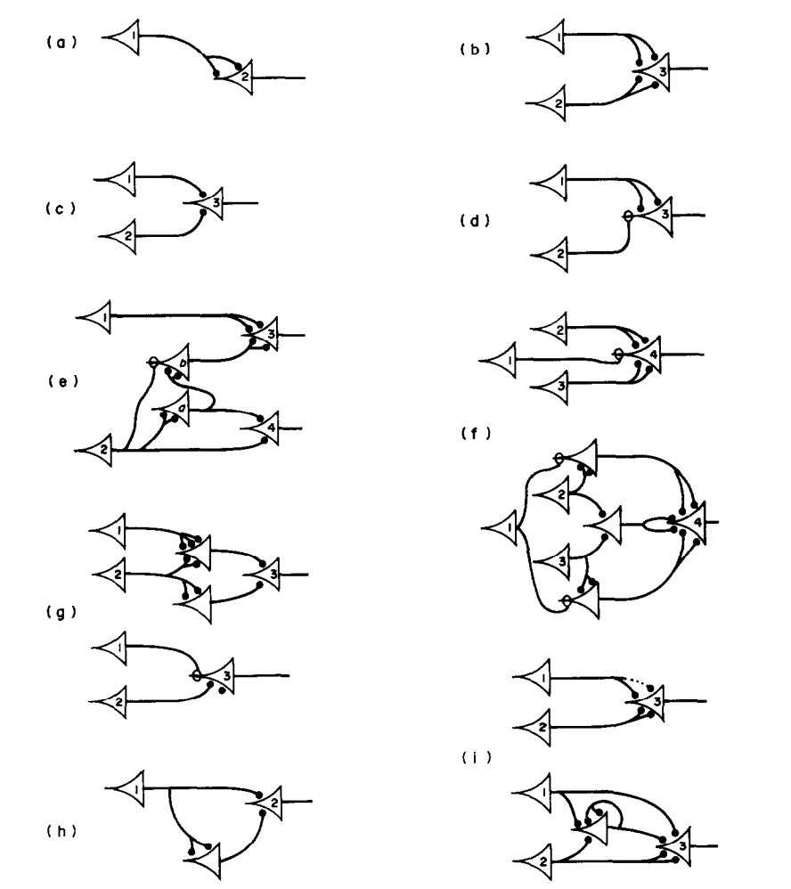
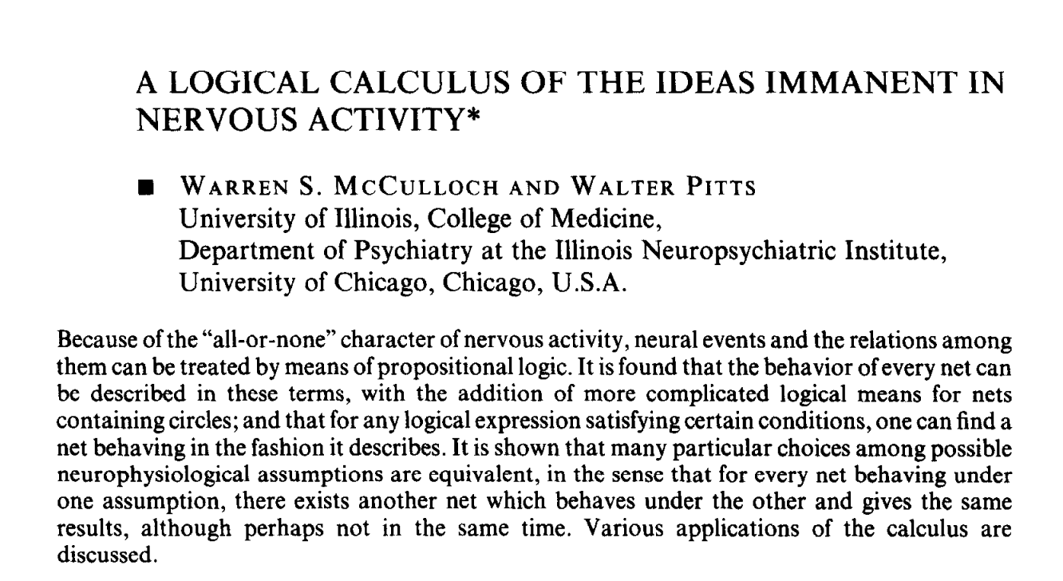
Progress in AI
Many advances are due to neural networks
How old are neural networks?
McCulloch & Pitts (1943)
[Slide credit: Arman Cohan]
Notes:
Here is one of the earliest work in neural networks.
McCulloch & Pitts published a paper in 1943 where they discuss one the (if not the) first computational models for simulating a biological neuron.
I am actually not sure how seriously these were taken in the literature, but these fellas were really ahead of their time.

Slide 42
Progress in AI
Many advances are due to neural networks
How old are neural networks?
They’ve been around since the 1940s
But why have only recently we seen breakthroughs?
3 necessary forces had to come together!
[Slide credit: Arman Cohan]
Notes:
Now a natural question is, why now then? Why did it take us so much time to get here?
Well the answer is that, we needed several important ingredients.
Several forces have to come together!

Slide 43
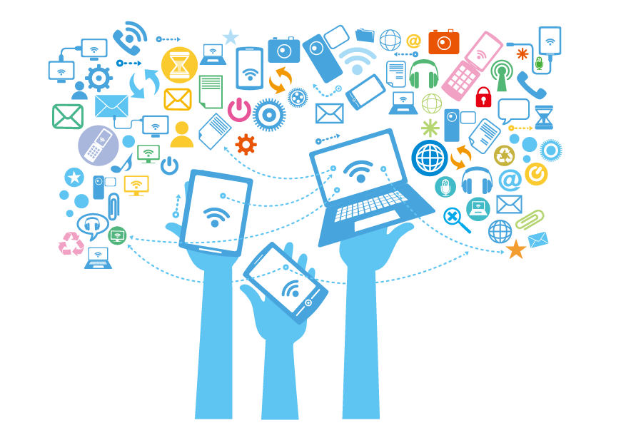
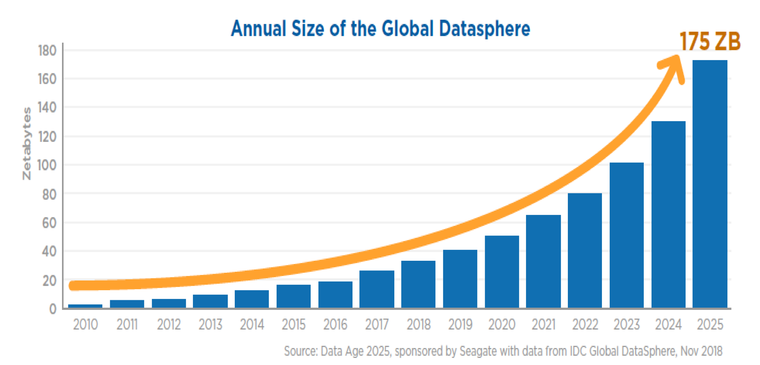
Force 1: Massive Amount of Data
Internet provided us with a massive repository of data.
Image source: https://www.forbes.com/sites/tomcoughlin/2018/11/27/175-zettabytes-by-2025/?sh=1e6ca8455459
Notes:
The first force is the availability of massive amounts of data.
It just happens that the internet contains massive amounts of data for us.
This chart shows the amount of data generated annually.
Not only the size of the internet is growing, but the speed with which it’s growing is also growing!
The amount of data that is available to us at our fingertips is just incomparable to what was available just 10 years ago.
What is remarkable is that, a few decades ago when engineers were designing the internet they didn’t mean it to become a datastore for AI systems. Quite remarkable when you think about it.

Slide 44
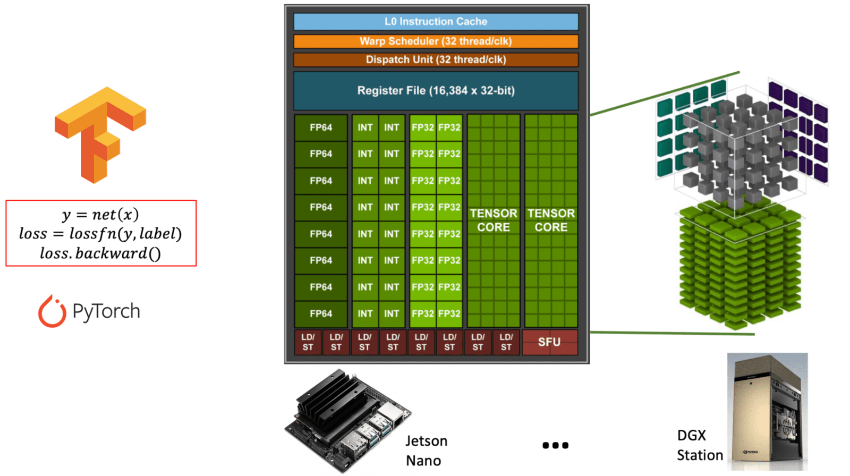
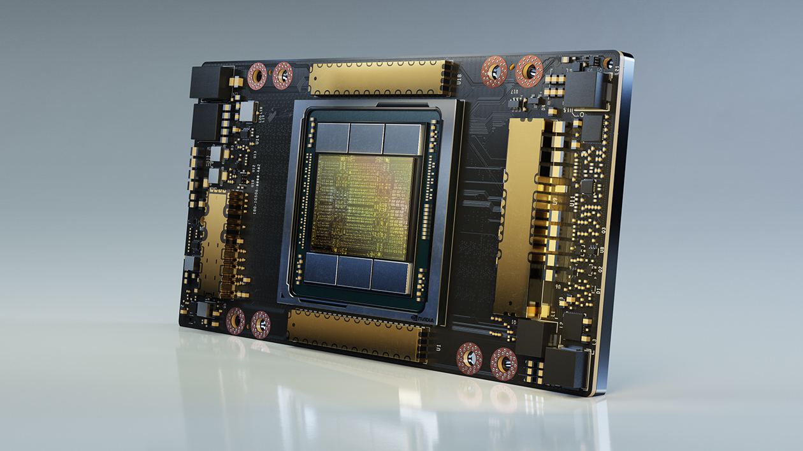
Force 2: Computing Power
Fast processors for deep learning!
A100 GPU
Notes:
The second force is our progress in building faster computational powers.
Each year our processors become faster than before.
In the last decade or so, we have seen the rise of GPUs that are effective in processing many parallel computations that are common in neural networks.

Slide 45
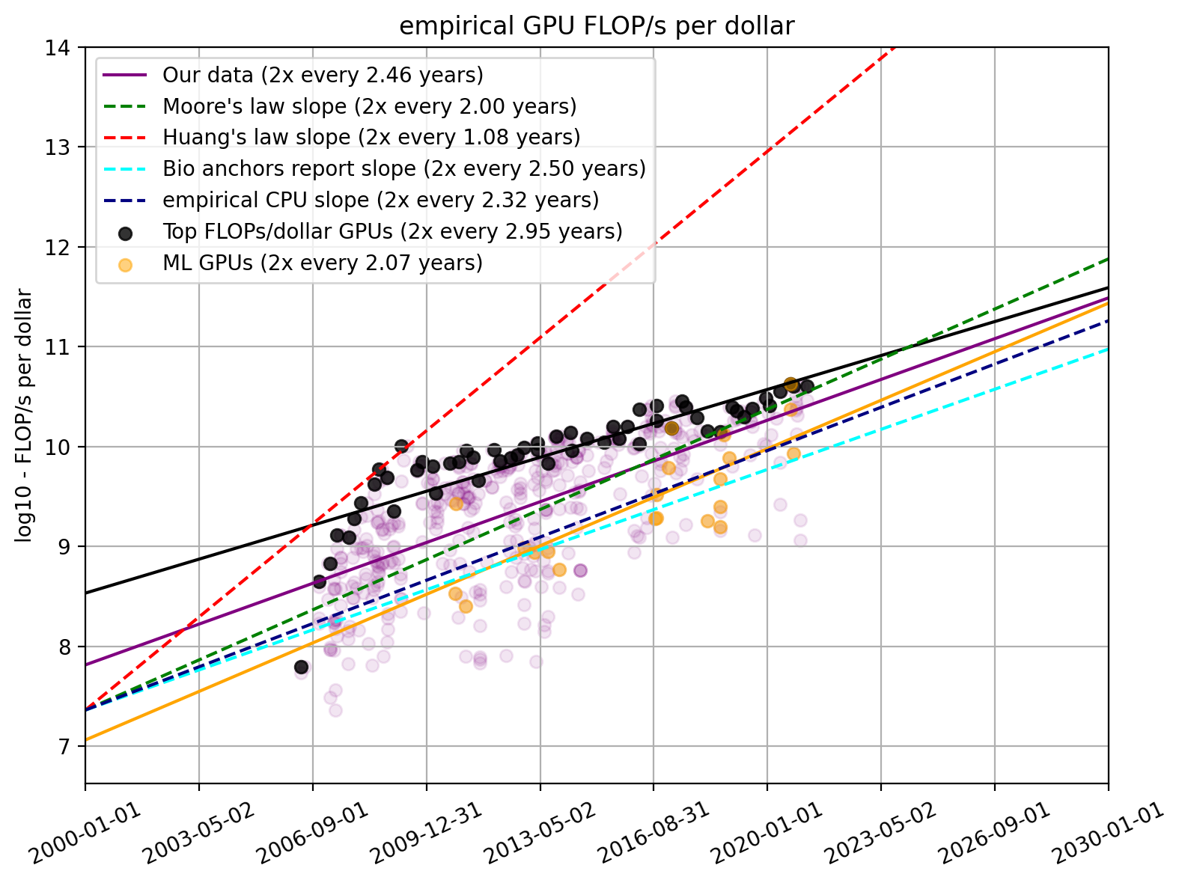
Force 2: Computing Power
Fast processors for deep learning!
Cheaper computing power over time.
The amount of computing power, per dollar
https://www.lesswrong.com/posts/c6KFvQcZggQKZzxr9/trends-in-gpu-price-performance
Notes:
While processors are getting faster, the money cost of computing is coming down.

Slide 46
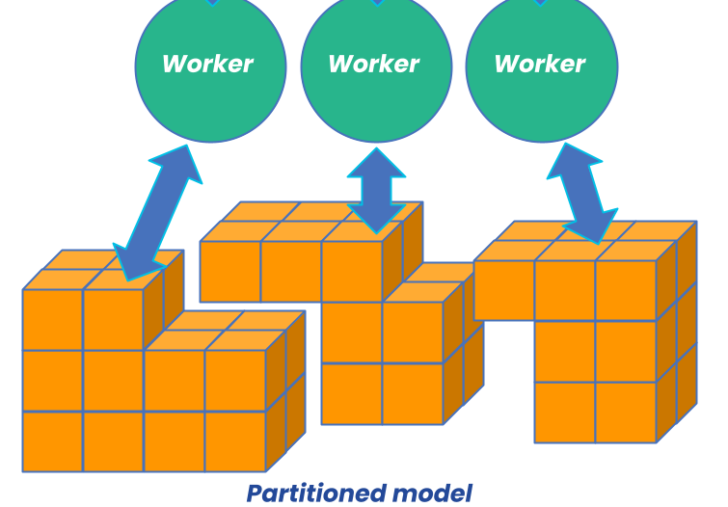
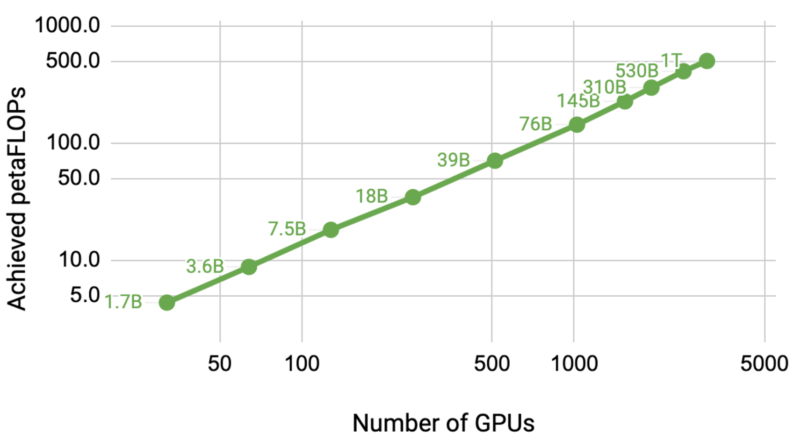
Force 2: Computing Power
Fast processors for deep learning!
Cheaper computing power over time.
Distributed training/inference allows us to scale to a larger set of processors.
Image source: https://developer.nvidia.com/blog/scaling-language-model-training-to-a-trillion-parameters-using-megatron/
Notes:
Moreover, we have learned how to scale up our approach by distributing our computational problems across many processors.
And by doing that, we are able to use much more computational power than what individual GPUs offer

Slide 47
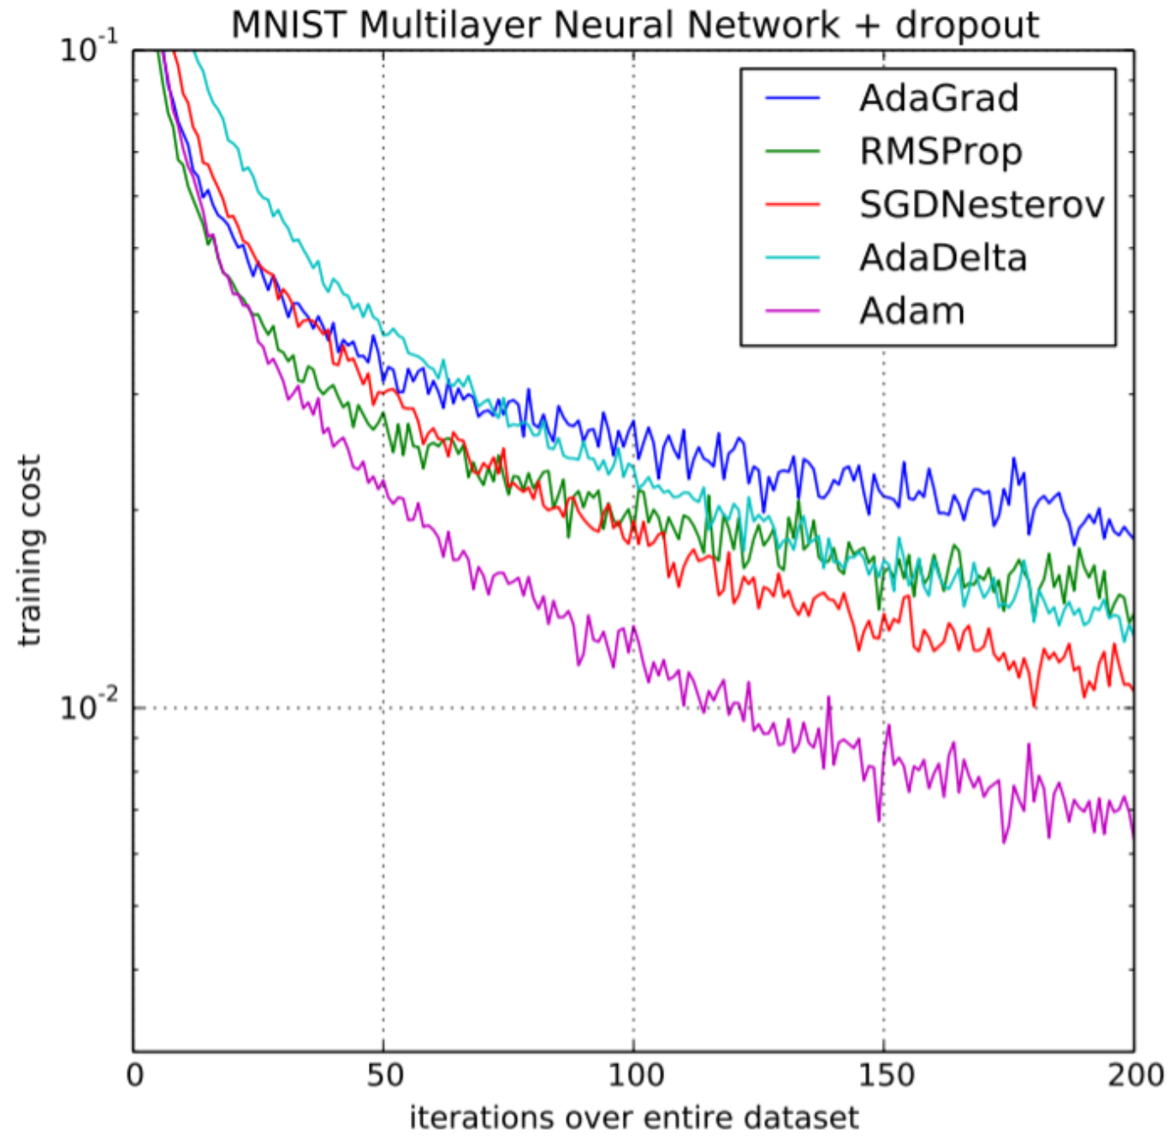
Force 3: Algorithmic innovations
Advances in optimization
Notes:
The last but not the least, is our scientific progress in AI
For instance,
There has been progress in the optimization of large neural networks.

Slide 48
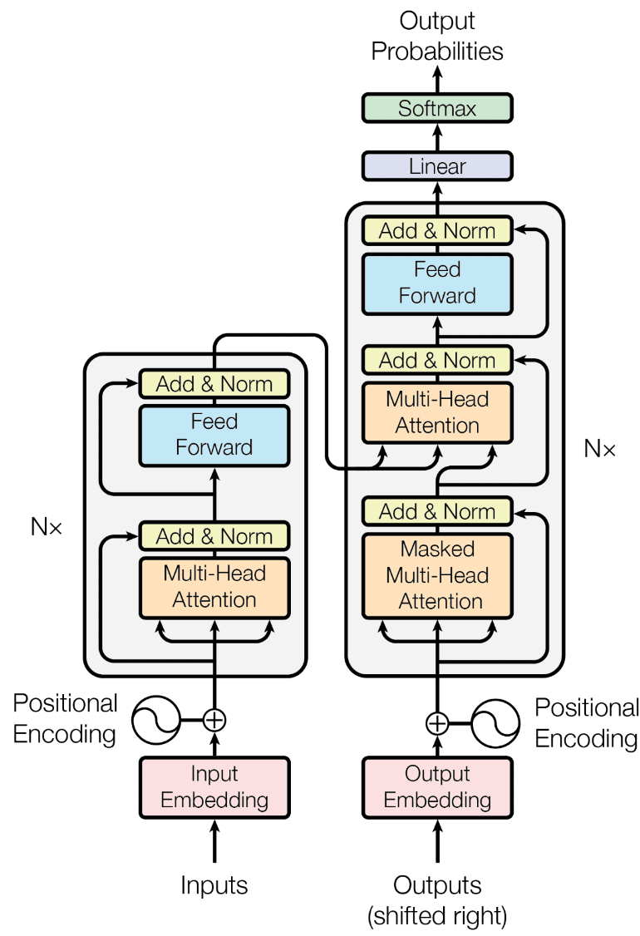
Force 3: Algorithmic innovations
Advances in optimization
Innovations in model architectures
….
Notes:
Or new architectures — at this point you might not know what this picture is, but we will go through these extensively.

Slide 49
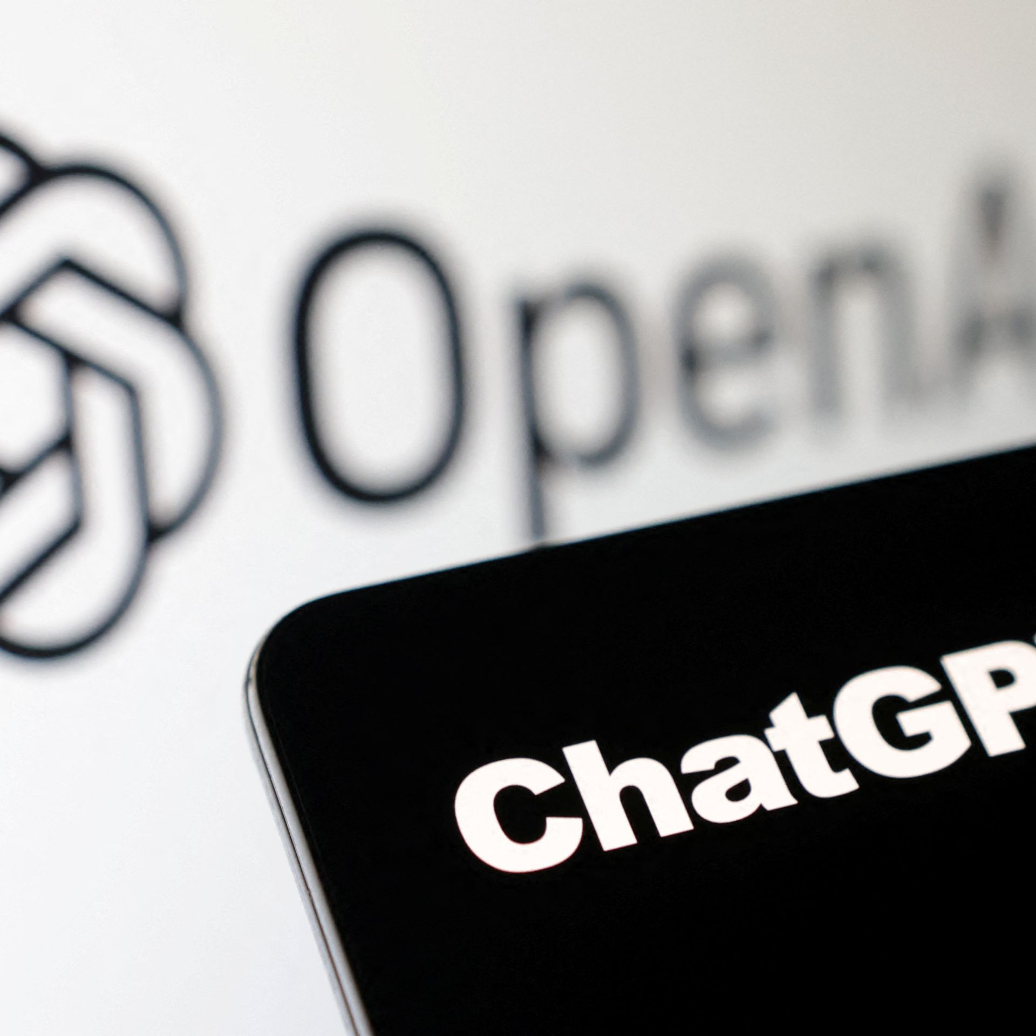




The success we dreamed of
Language models that are remarkably capable at solving many important NLP benchmarks.
Notes:
And putting together all these forces has given us the self-supervised models, that have been the backbone of the recent progress in AI.
So much so that some people got the impression that AI systems are closing in on human intelligence. Well, that’s something that we will debate. There is a lot to talk about on these.

Slide 50
Current state of Self-supervised Models
Almost every AI model is based on Neural networks
Performance is consistently improving with scale
More training data
Larger models (number of neural network parameters)
[Slide credit: Arman Cohan]

Slide 51
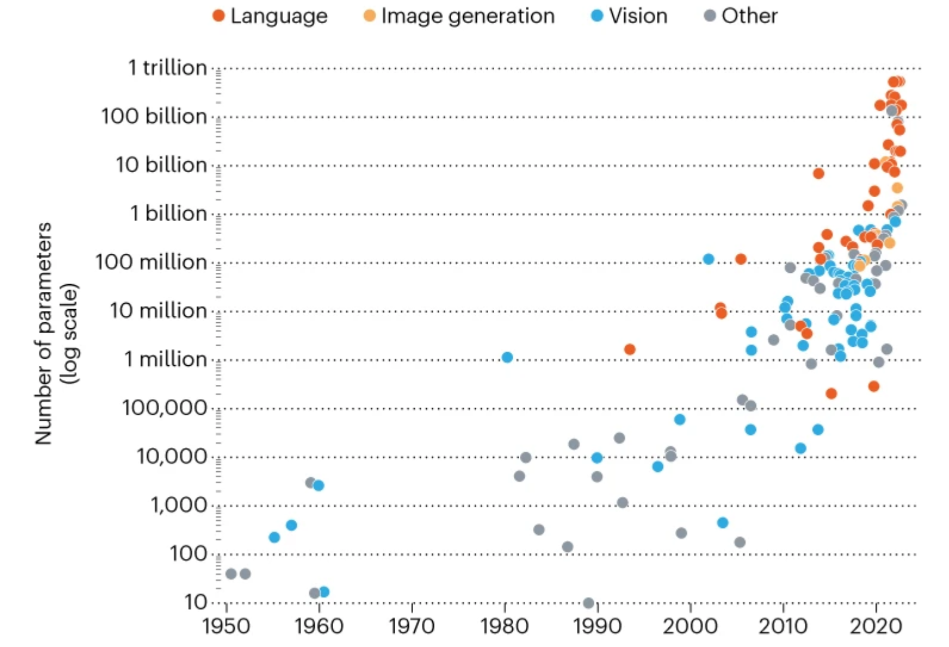
Current state of Self-supervised Models
State-of-the-art models are hundreds of billions of parameters
Image from: In AI, is bigger always better? https://www.nature.com/articles/d41586-023-00641-w
[Slide credit: Arman Cohan]

Slide 52



Current state of Self-supervised Models
PALM
State-of-the-art models are hundreds of billions of parameters
Trained on vast amounts of data (Trillions of tokens)
GPT-3
LLAMA
Image from: In AI, is bigger always better? https://www.nature.com/articles/d41586-023-00641-w
[Slide credit: Arman Cohan]

Slide 53
On terminology
These names are sometimes used interchangeably:
Self-supervised models
Pre-trained models
Generative AI models
Foundation models
Frontier models
…
Though they’re not exactly the same.
Notes:
I also make one clarification in terms of our terminology.
Many people in the field, use slightly different terms to refer to what I call “self-supervised learning”
[read them]
While these terms are quite relevant, they’re not exactly the same.

Slide 54
On terminology
These names are sometimes used interchangeably:
Self-supervised models
Pre-trained models
Generative AI models
Foundation models
Frontier models
…
Though they’re not exactly the same.
Our models are more than just “pretrained”!
Notes:
Pre-trained models: we will talk about this term extensively and you will see how it ties to self-supervised models.

Slide 55
On terminology
These names are sometimes used interchangeably:
Self-supervised models
Pre-trained models
Generative AI models
Foundation models
Frontier models
…
Though they’re not exactly the same.
~ Models that generate content
Notes:
“Generative AI” might be a name that you heard about in the news — it refers to category of AI models that can generate new content including text, images, audio, …
Not all self-supervised models are “generative”.
Not all “generative” models need to be self-supervised
We will see these throughout the course

Slide 56
On terminology
These names are sometimes used interchangeably:
Self-supervised models
Pre-trained models
Generative AI models
Foundation models
Frontier models
…
Though they’re not exactly the same.
~ can be used as a foundational component of modern AI systems
That doesn’t mean that these models are the foundation of AI!
More discussion on naming (Bommasani et al., 2021) https://arxiv.org/pdf/2108.07258.pdf
Notes:
“Foundation models” is an informal label for a large family of models that support a backbone of modern AI systems
The term “Foundation models” Doesn’t mean that these models are foundation of AI!!
This means majority of AI systems build on top of these models
The better foundation you have, the better AI system you will get in the end.
Poorly-constructed foundations are a recipe for weaker products
For now, it happens that all these “foundation models” are developed via supervised learning (synonymous for now)
But things may change in future. For example, self-supervised models might become the thing itself, as opposed playing a supportive role.

Slide 57
On terminology
These names are sometimes used interchangeably:
Self-supervised models
Pre-trained models
Generative AI models
Foundation models
Frontier models
…
Though they’re not exactly the same.
They’re user-facing “frontiers” of applications

Slide 58
On terminology
These names are sometimes used interchangeably:
Self-supervised models
Pre-trained models
Generative AI models
Foundation models
Frontier models
…
Though they’re not exactly the same.

Slide 59
On terminology
These names are sometimes used interchangeably:
Self-supervised models
Pre-trained models
Generative AI models
Foundation models
Frontier models
…
Which is your favorite? 😊
Notes:
Which name is your favorite?
I am not going to pick any favorites now — but I am sure you can infer that based on the name of this course!

Slide 60
ML
Deep learning
Self-supervised models
Generative AI
LLMs
[Slide credit: Arman Cohan]

Slide 61
Course Learning Objectives
We will cover a variety of inter-related topics:
Architectures
Pre-training
Alignment and safety
Efficiency
Interaction with the world (code, physical world, etc.)
Impacts on humans -- their misuse, biases, etc.
Skills:
Technical—understanding of the algorithms and implementing them.
Gaining intuitions about capabilities and limitations of models.
Soft skills—algorithms, PyTorch, SLURM, intuition about capabilities, teamwork.

Slide 62
Course Learning Objectives
Broad research question:
Reasoning: Understanding LLMs ability and limitations in performing complex, multi-step inference.
Long inputs/output: Understanding LLMs ability and limitations in processing long inputs and generating long outputs.
Efficient inference: Understanding the latest advances and hurdles in efficient inference.
Skills:
Technical—understanding of the algorithms and implementing them.
Gaining intuitions about capabilities and limitations of models.
Soft skills—intuition about capabilities, teamwork.

Slide 63
Course Logistics
CSCI 601-471/671 (NLP: Self-Supervised Models)
https://self-supervised.cs.jhu.edu/sp2025/

Slide 64
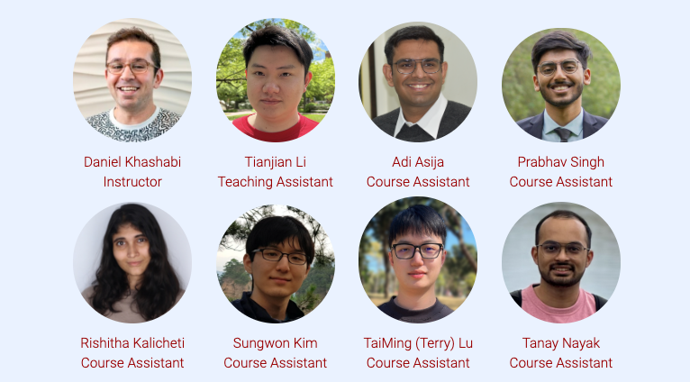
Course Logistics Brief
Instructor: Daniel Khashabi
I prefer just “Daniel”, as long as we act mutually respectfully.
No "prof Daniel"!! 🙅
TA: Tianjian Li
CAs: Sungwon, Tanay, Adi, TaiMing, Prabhav, Rishitha

Slide 65

Course Logistics Brief
Instructor: Daniel Khashabi
You can call me “Daniel”, as long as we act mutually respectfully.
Course Assistant: Anushri Suresh

Slide 66
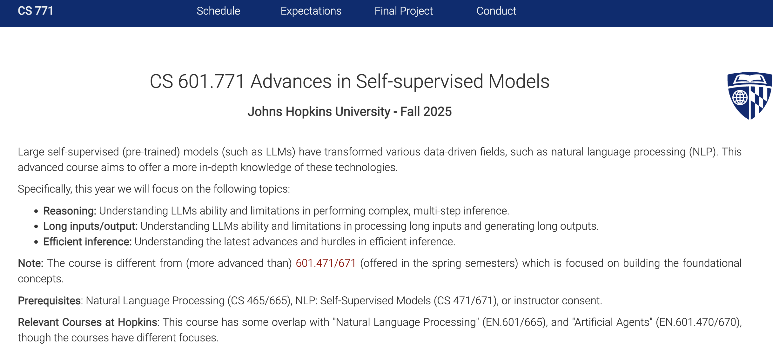
Course Website
Lots of important information on the website:
https://self-supervised.cs.jhu.edu/fa2025
Notes:
Now that we have defined what ”self-supervised models” let’s what’s in this class.

Slide 67
Course Prerequisites
Comfortable with programming, particularly Python
Comfortable with the foundations:
Transformer, pre-training, fine-tuning
Some basic understanding of alignment
HW1 should give a sense how prepared you are!

Slide 68
During the Class
A small team (usually 2 students) present 1-2 papers (20-25 minutes).
We (collectively as a class) will critically discuss the paper (remaining 30 mins).
This may also turn into open-ended conversation.

Slide 69
Before the Class
The presenter students:
You will know that you’re presenting 10 days in advance.
Anushri is in charge of assignments. Negotiate with her! :)
You need to share your slides with us 48 hours before the class.
We will give you feedback so that you can improve your slides.
The non-presenter students:
Write a one-pager summary of what was discussed last time.
A forcing mechanism to get us to think about what learned during the class.
At the beginning of each class, one of the students (randomly selected) will remind us what we talked about in the previous class based on their one-pager.

Slide 70
During the Class [Revised]
Beginning of the class: A student will remind us what we talked about in the previous class based on their one-pager.
A small team (usually 2 students) present 1-2 papers (20-25 minutes).
We (collectively as a class) will critically discuss the paper (remaining 30 mins).
This may also turn into open-ended conversation.

Slide 71
Grading Policy
One Homework (individual): 10%
In-class participation (individually): 20%
Discussions: Step Up/Step Back
Punctuality: being at class before we start
One-pager summary and its presentation: 20%
Paper presentation and critique: 20%
Final project (team): 30%
Skip days: You may skip up to 3 classes (during the dates that you're not presenting) with instructor consent ahead of time.

Slide 72
Final Project
Must be exploring a topic related to the focus of the class.
This is your chance to gain research experience on a topic of interest.
Topic choice will be (relatively) free. We will help you develop your ideas!
Deliverables:
Submit project proposal outline (for our formal review and suggestions)
To make sure that the project is scoped reasonably and doable in your limited time.
Get excited 🤩 and work on the project
Midway report
Final project presentation, poster session, report

Slide 73
Communication Mechanism
A Slack channel where:
We will have a room for sharing general discussions
Direct communication with me, if needed.
You can also create channels for your teamwork.
Are people comfortable with Slack?

Slide 74
HW1 is released!
Due Thursday next week.
Has both theory (background on algebra, etc.) and programming (building a classifier).
A baseline for self-assessment.

Slide 75
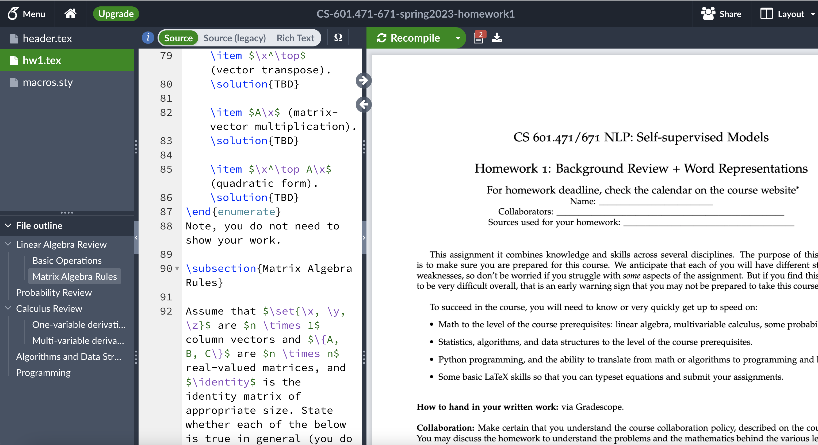
“Is Typesetting Mandatory?”
Yes!

Slide 76
Quick pulse check (1)
I have understood the course expectations!
Yes
No

Slide 77
Quick pulse check (2)
I am on the waitlist. Will I be able to register?
I don’t know.
However, typically, 20-30% of students drop the course within the first week. If you’re among the top 20 on the waitlist, there’s a good chance you’ll get in.

Slide 78
Quick pulse check (3)
I am currently on the waitlist and very eager to take this course. I’m optimistic about getting in. Should I submit the assignments even though I’m not officially registered?
Yes!
If you’re on the waitlist and excited to join, you should go ahead and submit the homework assignments.
Everyone—whether they joined late or were already registered—must adhere to the same deadlines.
No HW extensions for late joiners.

Slide 79
Wrapping it up!
HW1 is released!
If you’re not going to take this, drop the course!

